Slide 1
Human development
Introductory Psychology
Fall 2016
Prof: Dr. Doe Buchli, PhD

Slide 2
The Study of Human Development
Developmental psychology
Refers to field of psychology that examines physical, cognitive, and socioemotional change
Physical development
Involves maturation wherein the body follows a universal, biologically driven progression in a generally predictable pattern
Cognitive development
Includes changes in memory, problem solving, decision making, language, and intelligence that tend to follow a universal course early in life and considerable variability with age
Socioemotional development
Refers to social behaviors, emotions, and changes experienced in relationships, feelings, and overall disposition
Notes:
After maturation, physical changes continue, but not necessarily in a positive or growth direction.

Slide 3
The Study of Human Development
Biopsychosocial perspective
Recognizes contributions and interplay of biological, psychological, and social forces facing human development

Slide 4
Issues in Developmental Psychology
Nature and Nurture—what’s the interaction between our genes and our experiences?
Continuity and Stages—Which changes occur gradually, and which occur in clearly delineated stages?
Stability and Change—In what ways do we stay the same or change as we age?

Slide 5
Research Designs in Developmental Psychology
Cross-sectional design
Measure groups of people of different ages at a single point in time
Examples
Castel (2011)
Advantages
Allows comparison between age groups
Can be completed relatively quickly
Disadvantages
Cohort effects: members of each age group have lived through similar historical and cultural experiences, and this shared perspective may be responsible for differences across groups, rather than aging

Slide 6
Research Designs in Developmental Psychology
Longitudinal design
Measure a single group at different points in time
Examples
Small, Dixon, McArdle & Grimm (2011)
Advantages
Avoids cohort effects
Disadvantages
Practice effects
High attrition rate
Costly and requires many participants
Notes:
Curious to find out what lifestyle activities might help to slow the cognitive declines that accompany aging, Small, Dixon, McArdle, and Grimm (2011) studied 952 individuals over a 12 year period. Sent questionaires about cognitive abilities, activities, and health status every 3-4 years. The most engaged, active, and socially-supported had best long-term cognitive performance and were happier.
Advantage: avoid cohort effects
Disadvantage: practice effects, high-attrition rate, costly

Slide 7
Research Designs in Developmental Psychology
Cross-sequential design
Measure groups of people of different ages at different points in time
Advantages
Shows changes within individuals across groups
Avoids cohort effects
Disadvantages
Practice effects
High attrition rate
Costly and requires many participants
Notes:
05 The Developing Child
https://www.youtube.com/watch?v=CvN_YoFz2Z8
Watch again, take notes

Slide 8
INFANCY AND CHILDHOOD

Slide 9
NEWBORN GROWTH AND DEVELOPMENT
Rooting and sucking reflexes
Unlearned patterns of behavior
Some necessary for survival (i.e., rooting, sucking)
Some fade early in life; many resurface as voluntary movements.
Notes:
Rooting and sucking reflexes
Unlearned patterns of behavior
Some necessary for survival
Some fade early in life; many resurface as voluntary movements.
Rooting: Typically disappears at 4 months
Sucking: Do not fully mature until 33 to 36 months of age

Slide 10
NEWBORN GROWTH AND DEVELOPMENT
Newborn senses
Prefer human faces as opposed to geometric shapes
Discriminate mother’s voice shortly after birth
Distinguish smell of mother’s breast milk
Prefer sweet tastes, react to sour tastes, notice differences in breast milk taste
React to sense of touch
Respond to pain
Have blurred vision for several months
Notes:
Startle reflex

Slide 11
Brain Development in the Womb
Starts with development of the neural tube (16 days after conception)
Develops into forebrain, midbrain, hindbrain over next few weeks
Continues to develop throughout pregnancy
In the womb, the number of neurons grows by about 750,000 new cells per minute in the middle trimester!
Notes:
Forebrain is outer cortex
Midbrain is pro-perception, pain perception
Hindbrain is primitive: respiration, heartbeat

Slide 12
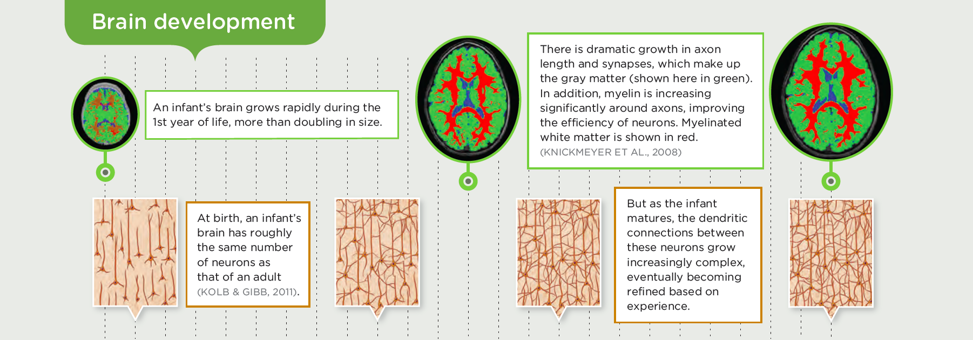
INFANT BRAIN DEVELOPMENT
Notes:
Rapid brain development in womb and immediately after birth
Creation of new neurons mostly complete by end of fifth month of fetal development.
About 100 billion neurons at birth

Slide 13
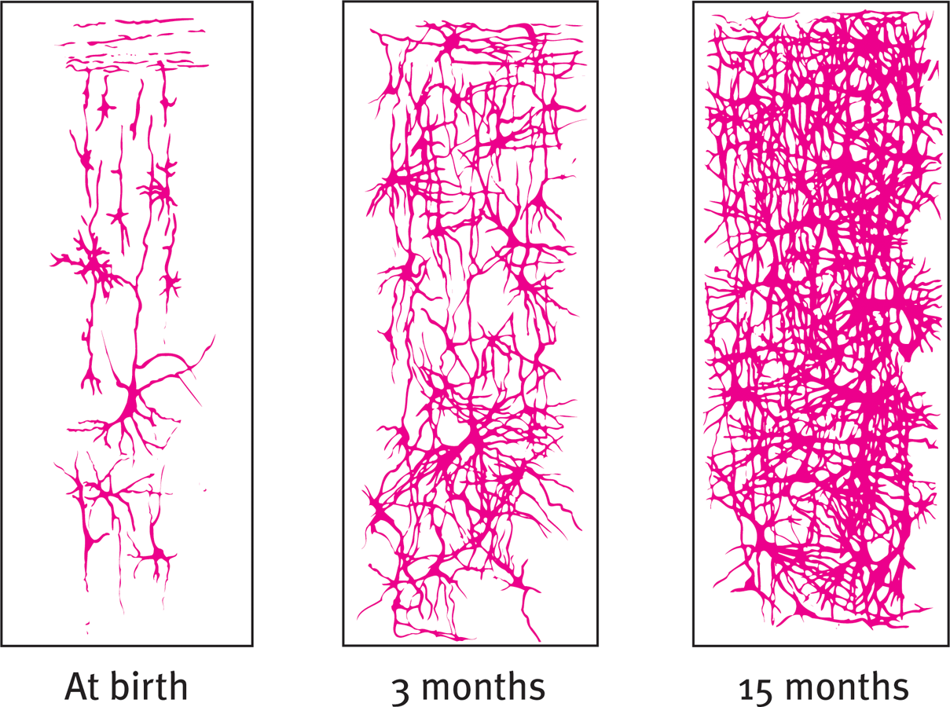
Brain Development in Infants
Networks between neurons continue to develop as you learn
Infancy: Brain stem, limbic system, motor and sensory strips.
Body functions and basic survival skills.
Early childhood: association areas.
Attention, control (frontal lobes), thinking, memory, and language.

Slide 14
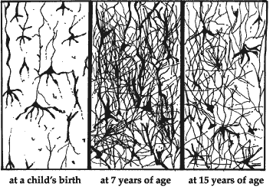
Brain Development in Childhood to Young Adulthood
Synaptic pruning
Getting rid of weak or unused connections, allowing more productive ones to become stronger
Decrease in neural connection by 40 to 50 percent by puberty
‘Sculpting’ of functional networks
Continues into our 20s

Slide 15
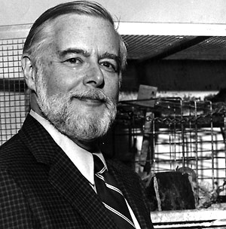
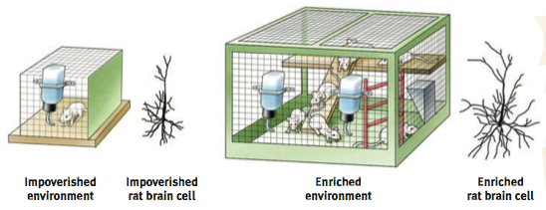
Rats with enriched environment experienced greater increases in brain weight and synaptic connections.
Notes:
Between the ages of 3 and 6, for example, the greatest increase in neural connections occurs in the frontal lobes, the area of the brain involved in planning and attention.
As more links are established, more associations can be made between different stimuli, and between behavior and consequences.
Number decreases by 40 to 50 percent by the time a child reaches puberty.
In a process known as synaptic pruning, unused synaptic connections are downsized or eliminated.

Slide 16
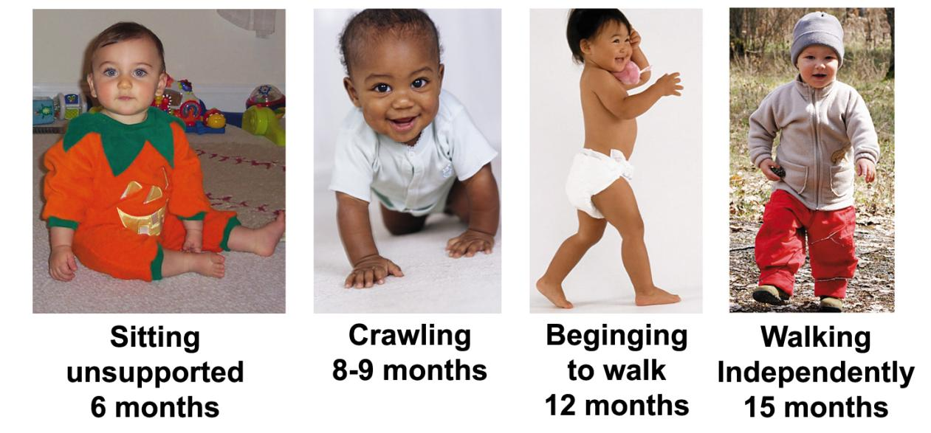
Motor Development
Maturation takes place in the body and cerebellum enabling the sequence below.
Physical training generally cannot change the timing.
Beginning
Notes:
Studies on identical twins have shown that rushing kids to learn to walk, learn to climb stairs, etc. does not seem to do much to make it happen sooner than it would happen anyway.

Slide 17
The Amazing Feat of Language Acquisition
Babies come into the world completely unable to use language (explains infantile amnesia)
Yet, by the age of 6 most kids have amassed a vocabulary of 13,000 words!
How does this happen?

Slide 18
Behaviorism and Language
Proposes that all behavior—including language—is learned through associations, reinforcers, and observations
Suggests language is learned through positive attention to correct behavior and unpleasant attention to incorrect behavior
Problems for theory
Learn too quickly
Novel utterances
Errors
Notes:
Behaviorists propose that all behavior— including the use of language—is learned through associations, reinforcers, and observation. Infants and children learn language in the same way they learn every- thing else, through positive attention to correct behavior (for example, praising correct speech), unpleasant attention to incorrect behavior (for example, criticizing incorrect speech), and the observation of others.

Slide 19
Language Acquisition Device
Universal, innate mechanism for language learning (Chomsky)
Children compare the language they hear in their environment to a framework already hardwired in their brains
The fact that children all over the world seem to learn language in a fixed sequence, and is evidence that this innate language capacity may exist.
Infant-directed speech (IDS)
Used by caregivers worldwide and stimulates infant attention to socially appropriate partners

Slide 20

Sequence of acquisition
Cooing
Babbling
Telegraphic speech
Getty Images/Blend Images
Notes:
Cooing: Production of vowel-like sounds by infants, often repeated in a joyful manner.
Babbling: The combining of consonants with vowels typically displayed at the age of four to six months.
Telegraphic speech: Two-word phrases typically used by infants around the age of 18 months.

Slide 21
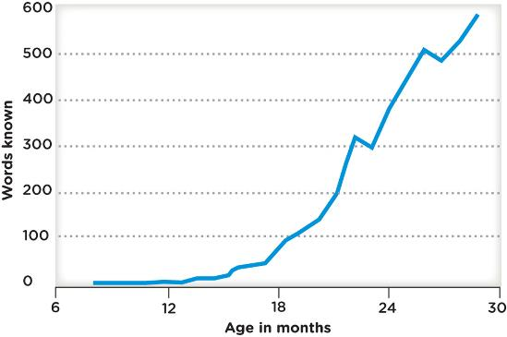
The Vocabulary Explosion
Around the second year of life, the rate at which a child learns new words begins to increase dramatically.
By five to six years old, most children are fluent in their native language, although their vocabulary does not match that of an adult.

Slide 22
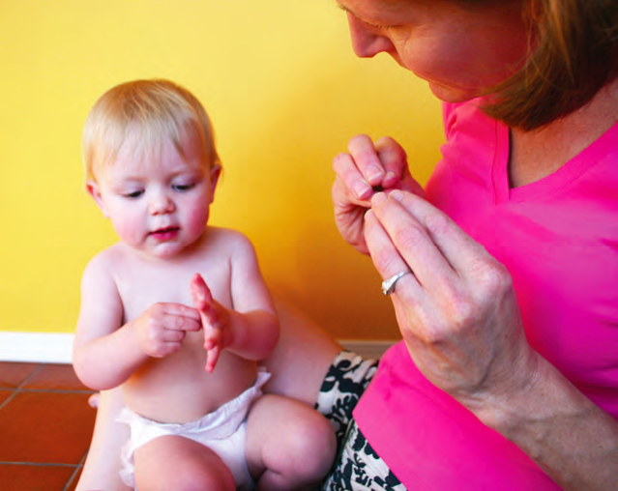
Benefits of Sign
Introducing sign to children as young as 6 months may help them communicate before they use verbal speech. (Doherty-Sneddon, 2008)
Early use of sign may also provide a verbal advantage down the road when they enter elementary school. (Barnes, 2010)
A baby and a caregiver communicate with sign
language.

Slide 23
Language in the environment
Amount of language in home correlates with SES
Number of words per minute spoken to toddlers:
High-income: 35 words
Middle-income: 20 words
Low-income: 10 words
Lag in reading, math, and academic achievement in general found in lower SES status children beginning school
Notes:
SES – socioeconomic status

Slide 24
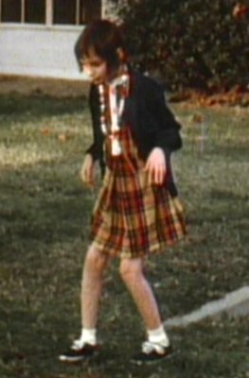
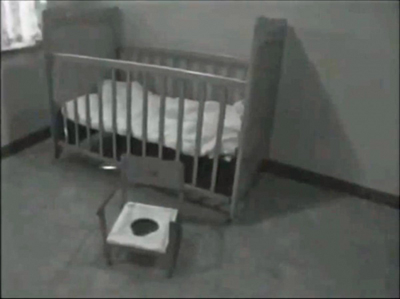
Genie, the “wild” child

Slide 25
Critical Periods
Specific time frame in which an organism is sensitive to environmental factors, and certain behaviors and abilities are readily shaped or altered by events and experiences.
Notes:
Critical hypothesis

Slide 26
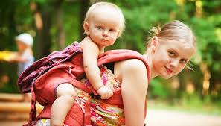
Attachment
Refers to degree to which infant feels emotional connection with primary caregivers
Notes:
Secure: 65 percent; upset when mother leaves but easily soothes upon her return; confident that needs would be met; used mother as secure base
Avoidant: 20 percent; no distress when mother left and no interaction when she returned
Ambivalent: 10 percent; very upset when mother left and unable to be soothed; displayed anger and not interested in returning to play

Slide 27
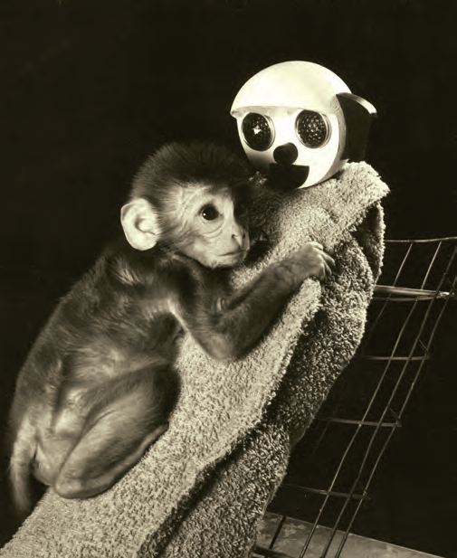
Soft Like Mommy
Research by Harry and Margaret Harlow and colleagues at the University of Wisconsin showed that physical comfort is important for secure attachment, not just being rewarded with food
Notes:
Here’s how the experiment worked: Infant monkeys were put in cages alone, each with two artificial “surrogate” mothers. One surrogate was outfitted with a soft cloth and heated with a bulb. The other surrogate mother was designed to be lacking in “con- tact comfort,” as she was made of wire mesh and not covered in cloth. Both of these surrogates could be set up to feed the infants. In one study, half the infant monkeys received their milk from the cloth surrogates and the other half got their milk from the
wire surrogates. The great majority of the infant monkeys spent most of their time clinging to or in contact with the cloth mother, even if she was not the mother providing the milk. The baby monkeys spent 15 to 18 hours a day physically close to the cloth mother, and only 1 to 2 hours touching the wire mother. Harlow and colleagues also created situations in which they purposefully scared the infants with a moving toy bear, and found that the great majority of the infant monkeys (around 80%) ran to the cloth mother, regardless of whether she was a source of milk. In times of fear and uncertainty, these infant monkeys found more comfort in the soft and furry mothers. Through their experiments, Harlow and his colleagues showed how important physical contact is for these living creatures (Harlow, 1958; Harlow & Zimmerman, 1959)
Cloth mother is a “secure base”

Slide 28
Attachment Variation: Styles of Dealing with Separation
The degree and style of parent-child attachment has been tested by Mary Ainsworth in the “strange situations” test. In this test, a child is observed as:
a mother and infant child are alone in an unfamiliar (“strange”) room; the child explores the room as the mother just sits.
a stranger enters the room, talks to the mother, and approaches the child; the mother leaves the room.
After a few moments, the mother returns.
Reactions to Separation and Reunion
Secure attachment: most children (60 percent) feel distress when mother leaves, and seek contact with her when she returns
Insecure attachment (anxious style): clinging to mother, less likely to explore environment, and may get loudly upset with mother’s departure and remain upset when she returns
Insecure attachment (avoidant style): seeming indifferent to mother’s departure and return

Slide 29
The Strange Situation: Criticisms
Most of early work used mothers; subsequent research should examine attachment to multiple caregivers.
Artificial environment created and does not mirror natural environment.
Cross-cultural differences not always addressed.

Slide 30
Cognitive development
JEAN PIAGET

Slide 31
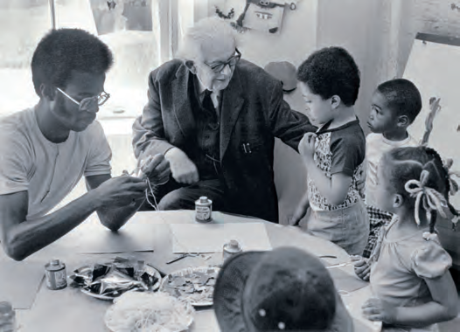
Developmental psychologist Jean Piaget (center) works with students in a New York City classroom. Piaget’s research focused on school-age children, including his own three, who became participants in some of his studies. Children think differently from adults, Piaget proposed, and they experience cognitive development in distinct stages.

Slide 32
PIAGET AND COGNITIVE DEVELOPMENT
Schema
Collection of ideas that represent a basic unit of understanding
Assimilation
Using existing information and ideas to understand new knowledge and experiences
Accommodation
Restructuring of old ideas (schema) to make a place for new information (schema)

Slide 33



Infant develops schema for “dog”
Infant GENERALIZES concept and tries to assimilate “cat” into “dog” schema. Parent corrects infant: “This is a cat.”
Infant accommodates animal schema and develops separate categories for dogs and cats.

Slide 34
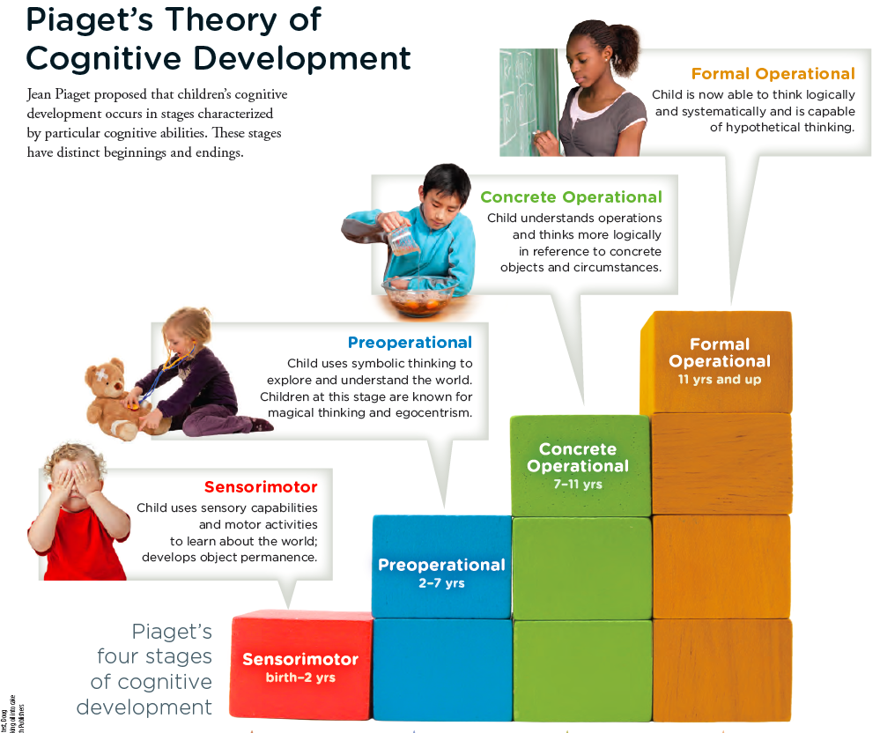

Slide 35
Stage 1: Sensorimotor
0 -2 yrs
Experience world through senses and actions
Begin to develop object permanence
Understanding that objects continue to exist even when they are out of sight
Notes:
Hearing, looking, touching, sucking
Sensorimotor
Object permanence: Realization that objects and people still exist when they are out of sight
Object permanence can happen earlier as soon as 2 months, 3 months,

Slide 36
Stage 2: Preoperational
2-7 yrs
Represent objects with words and images
Develop ability to engage in pretend play
Develop theory of mind (around age 4 or 5)—ideas about their own and others’ mental states
Cannot understand conservation
Notes:
Preoperational
Language used to explore and understand world.
Egocentrism occurs as children only imagine the world around them from their own perspective.
Operations not yet mastered, such as conservation and reversibility
Unable to understand conservation
Age of 2, explosion of language
Autism hasn’t developed theory of mind?

Slide 37

Before theory of mind: Egocentrism “I am the World.”
Do you have a brother?
Yes. Jim.
Does Jim have a brother?
No.
Notes:
Answer to the slide question: this boy is unable to see his brother Jim’s perspective and unable to see himself as a brother rather than just as ME, the center of the world.
Egocentrism is another one of those terms that has a different meaning in psychology than in its more vague popular use. It is not about selfishness, but about being unable to see another person’s perspective, or even to imagine that other people have a perspective that might be different from your own.
Hiding their eyes: If I can’t see, you can’t see, right? If the world has just become dark, how can anyone else see?
Egocentrism is also a hallmark of autism, to such an extent that if you point somewhere, an autistic child might look at the end of your finger or at a point past the finger from their perspective, rather than being able to tell where you are looking.

Slide 38
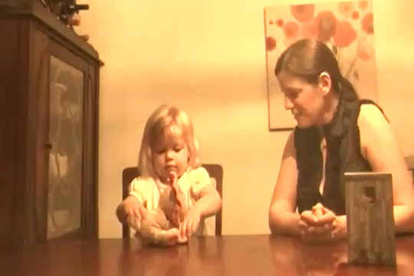
Testing Theory of Mind with the False Belief Test
http://www.youtube.com/watch?v=XEhjsQtIqV0
Notes:
http://www.youtube.com/watch?v=XEhjsQtIqV0

Slide 39
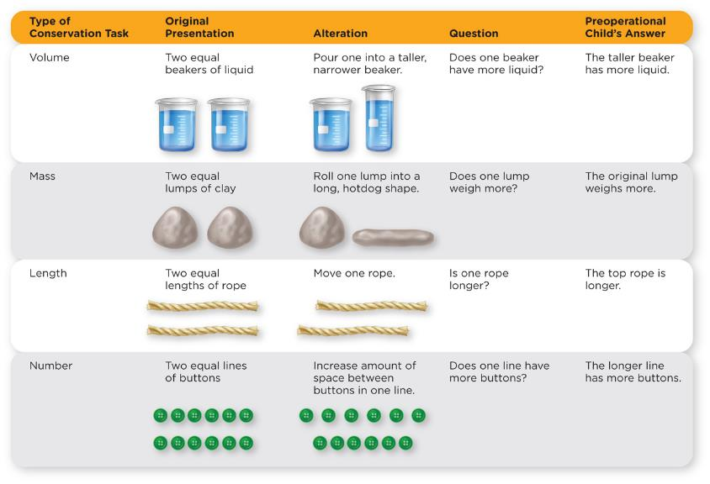

Slide 40
Stage 3: Concrete Operational
7-11 yrs
Think logically about concrete events and understand concrete operations
Begin using analogies (e.g., “My brain is like a computer”)
Develop mathematical abilities (e.g., arithmetic transformations… if 4 + 8 = 12, 12 – 4 = ?)
Understanding of conservation
Notes:
Concrete operational
Thinking is more logical, but mainly in reference to concrete objects and circumstances
Less egocentric and can master conversation
Can understand conservation

Slide 41
Stage 4: Formal Operational
11+ yrs
Develop ability to engage in abstract reasoning (hypothetical thinking and systematic reasoning)
Formal operations includes allegorical thinking such as “People who live in glass houses shouldn't’t throw stones” (understanding that this is a comment on hypocrisy).
Includes algebra:
if x = 3y and x – 2y = 4, what is x?
Notes:
Formal operations
Linking becomes more logical and more systematic
Logical abilities more likely developed in relationship to interests and skills developed in their environment

Slide 42
PIAGET AND COGNITIVE DEVELOPMENT
The critics
Cognitive stage with distinct characteristic; transitions more likely continuous
Cognitive abilities underestimated
Object permanence occurs sooner.
Formal operational stage may not be last stage; distinctions needed between adolescents and adults of various ages.

Slide 43
Moral development
LAWRENCE KOHLBERG

Slide 44
Moral Development: Kohlberg
Kohlberg believed...and was able to demonstrate through studies...that people progressed in their moral reasoning (i.e., in their bases for ethical behavior) through a series of stages. He believed that there were six identifiable stages which could be more generally classified into three levels.

Slide 45
The stages include growth from self-centeredness to other-centeredness.
Self-centeredness Other-centeredness

Slide 46
The capacity to reason also grows from reliance on external authority to fidelity to internalized values
External Authority Internalized Values

Slide 47
Stages of Moral Development Lawrence Kohlberg
Level | Stage | Ages | Social Orientation
Pre-Conventional | 1 | 2-4 | Obedience and Punishment
 | 2 | 4-7 | Individualism, Instrumentalism
Conventional | 3 | 7-10 | Good Boy/Girl
 | 4 | 10-12 | Law and Order
Post-Conventional | 5 | Teens | Social Contract
 | 6 | Adult | Principled Conscience

Slide 48
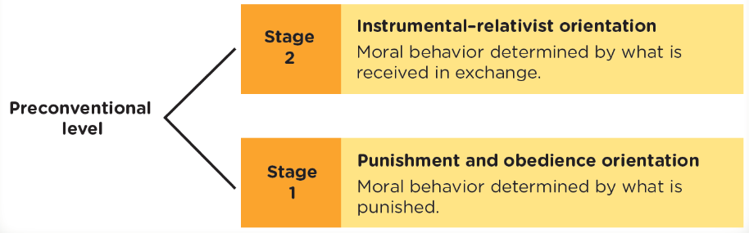
Kohlberg’s Stages of Moral Development
Notes:
Pre-conventional level is based on operant conditioning
very egocentric.
Determined by “what is received”
Very selfish

Slide 49
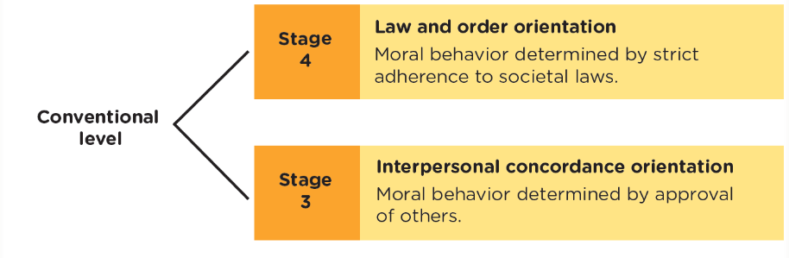
Kohlberg’s Stages of Moral Development
Notes:
Starting to think of himself to other people
Moral behaviour – behaviour that will get you approval from other people

Slide 50
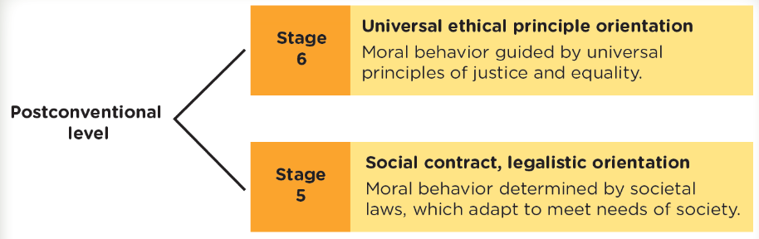
Kohlberg’s Stages of Moral Development
Notes:
Stage 6, most people don’t reach this level

Slide 51
Do you understand Kohlberg’s stages of moral development?
Test your knowledge with the following activity!
What level of moral reasoning is demonstrated in each of the following examples?

Slide 52
Shaking her head and frowning disapprovingly at the teenager who was slipping a candy bar from the shelf into the pocket of his jacket, a shopper lectured, “You know as well as I do that shoplifting is against the law. What if everyone just did what they wanted?”
Notes:
Stage 4 - Fulfilling duties and upholding the law to maintain social order. Motivated to keep the social system going and to avoid a breakdown in its functioning.

Slide 53
Amy’s mother has insisted that Amy not eat snacks between meals. Now, if Amy should eat this Twinkie before dinner, she should be unhappy when thinking about how she would be disappointing her mother.
Notes:
Stage 3 - Amy has to be a “good girl.” Her good behavior is doing what is expected by people who are close to the person or what people generally expect of someone in a given role.

Slide 54
Well, Amy ate the Twinkie. When talking with a friend about it the next day, Amy’s friend told her that she (Amy) was bad because her mother caught her eating snacks between meals and punished her for it.
Notes:
Stage 1 - Doing what is right is being obedient. The conscience is made up of fear of punishment and the moral action is motivated by the avoidance of punishment. The child does not consider the interests of others or see how someone else’s interests are different from their own.

Slide 55
You are distressed when your boss asks you to charge a late fee to customers who miss the deadline. You believe that a late fee is clearly unjustified; late orders cause no real difficulty and cost the company no more to process than early orders. While you recognize the right of the company to make a profit, you insist that a late fee is not fair to the customer.
Notes:
Stage 5 - being right involves upholding rules that are in the best interest of the group. Rules should be impartial, and agreed upon by the group. If the rule no longer promotes the welfare of individuals, then the rules become invalid.

Slide 56
Conversation overheard in a cafeteria line: “Why should I want to report the guy for failing to submit all the money we collected for the charity fund? Sure he kept some of it, but he shared it with me.”
Notes:
Stage 2

Slide 57
People at this stage have developed their own set of moral guidelines which may or may not fit the law. The principles apply to everyone.
E.g. human rights, justice and equality. The person will be prepared to act to defend these principles even if it means going against the rest of society in the process and having to pay the consequences of disapproval and or imprisonment.
Kohlberg doubted few people reached this stage.
Notes:
Stage 6

Slide 58
KOHLBERG’S STAGES OF MORAL DEVELOPMENT
The critics
Women’s moral reasoning not represented; importance of caring and responsibility discounted. (Gilligan)
Theory primarily applicable to Western, collectivist cultures
Moral behavior is defined, but it is not predicted or explained.

